Slide 1
The University of California UAS Safety Management System
Brandon Stark, Director
Unmanned Aircraft System Safety
Center of Excellence
University of California

Slide 2
Topics
UAS Safety
Safety Management System
Policies
Risk Management
Safety Assurance
Safety Promotion
Moving forward

Slide 3
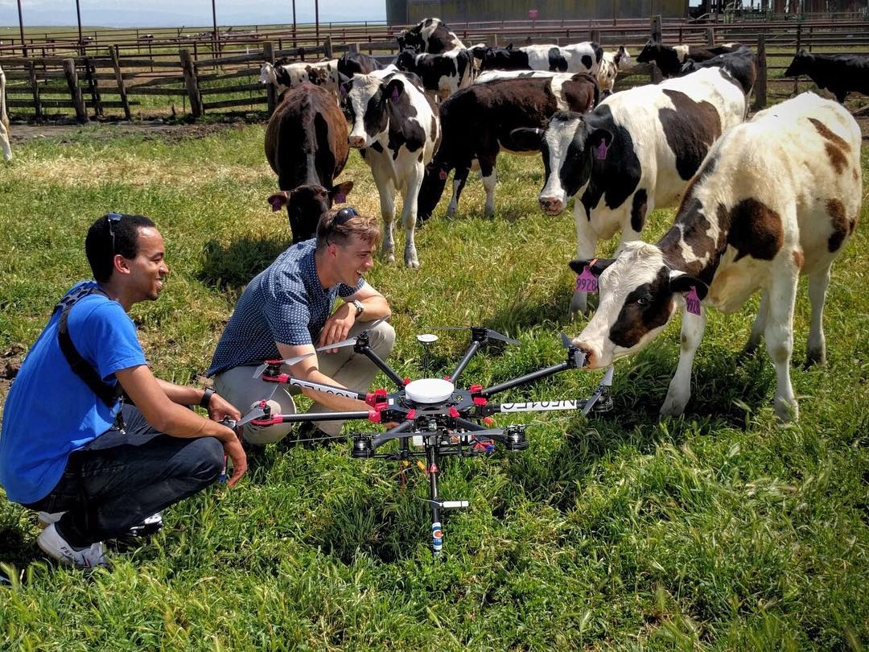
What UAS activity is already occurring in the UC system?
Nearly every campus has a ‘Drone Lab’
Largely Engineering groups
Increased interest in Environmental, Agricultural, Archeological, and Ecological research groups
Journalism, Facility Management, Publicity/Multimedia groups

Slide 4
UAS Vocab
UAS – Unmanned Aircraft System
COA – Certificate of Authorization, applies for both Public Agencies or Commercial UAS flights
Part 107 – New SUAS Regulations (Aug 29th, 2016)
Pilot Certificate – Pilot’s license
Remote Pilot Certificate – New SUAS RPIC license
RPIC – Remote Pilot in command
UAS Registration – Each aircraft must have an FAA number (starts with N or FA)
SUAS – Small UAS (under 55 lbs)
Section 333 Exemption – Congressional exemption from the prohibition of commercial UAS flights
VO – Visual observer

Slide 5
Center of Excellence on Unmanned Aircraft System Safety
One-stop shop for all things UAS
Services
Answer any question about drones, regulations, safety, risk management, applications or research
Files permissions and requests on behalf of faculty/staff
Provide reports on UAS activity
UAS Safety Management System

Slide 6
UAS or Model Aircraft
Aircraft
Model Aircraft are defined as a subset of Unmanned Aircraft.
Model Aircraft are differentiated from Unmanned Aircraft only by the purpose in which they are flown
Sec 336 in H.R. 658 – “The FAA Modernization and Reform Act of 2012”
Unmanned Aircraft
Small
Unmanned Aircraft
Model Aircraft

Slide 7
How does the UC get flight authorizations
Details in a separate presentations
Public Agency Operations (PAO)
UC-Owned Aircraft
Only for public research purposes
No hard-restrictions on operations
International students
Recreation/Education
Student Recreation
Student Curriculum
Not for research
Stop
Not Legal
Section 333 Exemption
UC-Owned Aircraft
Only specific UAS models allowed
Requires Private Pilot’s License
Used for very specific cases
Small UAS Regulations (Part 107)
Any aircraft
Requires SUAS License ($150)
Up to 400 ft, Line of Sight, Daylight only
For Research, Commercial, University Business, Journalism, Film and Photography

Slide 8
UC User Flight Workflow
Registered Aircraft
Where:
When:
Purpose:
Pilot:
Aircraft:
Licensed Pilot
Fly!
Flight Request
To Center
(UC form)
Flight Authorized
Flight Report
(UC form)
Clear Airspace
File special permission with FAA
Details in a separate presentations

Slide 9
UC UAS Activity
How many UAS does the UC system have?
According to the FAA – 9
According to UCOP Risk Services – 73
According to my list – 130
The true number ~ 200-300
Where are the UASs flown?
According to the FAA – only in Davis and Merced since 2009
According to the news media – All over the US and the world
How many illegal UAS flights are being done by our UC students/faculty and staff?
The UC has a UAS problem!

Slide 10
What’s going wrong?
Lack of knowledge of UAS regulations
Don’t blame recent changes! – UAS have been heavily regulated since 2005
Recent changes have only decreased the number restrictions (by adding more alternative process with new rules)
Affects both for end-users and the campus administrators
Lack of value-added oversight
Current reporting mechanisms offer no improvement to regular use
Hard to encourage buy-in

Slide 11
“Legal” ≠ “Safe”
Just because you follow the letter of the law does not mean that you are guaranteed to be safe

Slide 12
Aviation Safety Management
Risk Index
Historical Data
Incident Severity
Fly
Crash
Fix
Even in model-building analysis, we still utilize statistics and probability to derive our risk management analytics

Slide 13
Aviation Safety Management
Unmanned Aircrafts have no historical data and technology developments far outpaces data collection effectiveness
Risk Index
Historical Data
Incident Severity
Fly
Crash
Fix
Even in model-building analysis, we still utilize statistics and probability to derive our risk management analytics

Slide 14
Introduction to Safety Management Systems
Ensuring safety with Unmanned Aircrafts requires a different approach that
Incorporates a dynamic risk management systems
Has built in mechanisms for improvement and
Scales appropriately to risk
This is exactly why the FAA has spent the past decade developing what is now known as Safety Management Systems (2006)

Slide 15
UAS Safety Management System
Safety Policies
Policies establish the organizational hierarchy and responsibilities at each level. They establish oversight requirements and processes to meet safety goals
Safety Risk Management
Provides a workflow for a formal process to describe the system, identify hazards, assess risk, and control/minimize risk.
Safety Assurance
Enable the evaluation of the effectiveness of risk management strategies and ensure compliance with other oversight entities, including the FAA, the Center, and OPRM.
Safety Promotion
Educational outreach on UAS policies and FAA regulations, training on UAS Risk Management and Safety Assurance. Developing a safety culture at all levels of UAS operations.

Slide 16
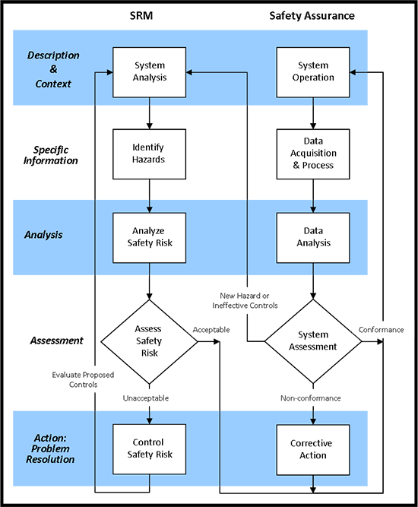
Safety Risk Management & Safety Assurance
Safety Risk Management and Safety Assurance are two separate processes
But its useful to think about how they interact

Slide 17
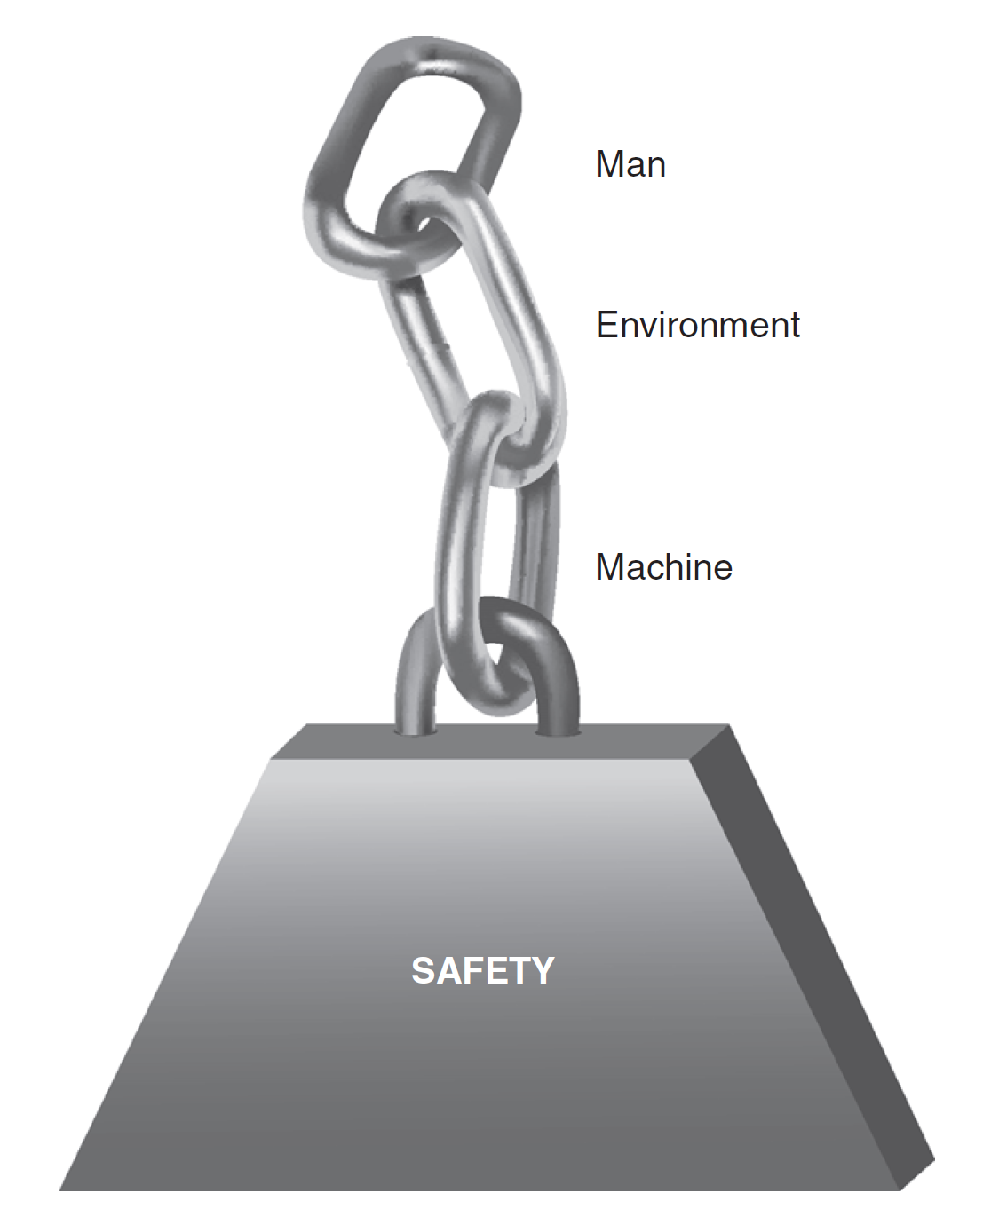
Safety Risk Management
Safety requires effective practices in managing risk from
The Aircraft
The Environment
The Human
Process
Identify hazards
Risk Analysis and Assessment
Controls for Risk
Residual Risk
System Operation

Slide 18
How to identify hazards?
Apparent
Crashing in to people, property, etc
Detailed
Autopilot settings
Hidden
High temperature or elevation
Loss of Visual Sight
Untrained operator
Too windy
Area not big enough
Loose screws
Improper failsafe controls
Improper training
Powerlines or other hard to see obstructions
Uncontrolled ground access
Rolling terrain wind hazards
Updrafts and downdrafts
Human Factors (fatigue, rush, etc)
Component wear
Emergency path planning
Flight path clearance

Slide 19
Safety
Is the human trained?
Each component is required for safety!
Is the airspace safe?
Is the aircraft ready to fly?
This chain helps us identify some risks, but not all

Slide 20
Visualizing the system to identify hazards
Software
Hardware
Environment
‘Liveware’
‘Liveware’
H
Use the SHELL Model to think about
Interaction within each component and
between each component
S
L
E
L
See Hazard Identification Questionnaire Pamphlet

Slide 21
SHELL Model
Software
Bugs in code
Process errors
Hardware
Airframe issues
Other equipment failures
Environment
Weather conditions
Liveware
Fatigue
Lack of training
Liveware
Management failure
Software
Hardware
Environment
‘Liveware’
‘Liveware’
H
S
L
E
L

Slide 22
SHELL Model
Human Factors are a major component of hazards
Software↔Liveware
How the user interacts with the non-physical aspects
Programming/Planning
Checklists/Processes
Hardware↔Liveware
Man & Machine
Ground Control Equipment
Environment↔Liveware
Man vs the environment
Too hot->inattention
Man vs the workplace environment
Liveware↔Liveware
Communication failures
Software
Hardware
Environment
‘Liveware’
‘Liveware’
H
S
L
E
L
After we identify hazards, we must analyze them

Slide 23
Analyze Hazards
Risk Assessment
Quantitative Statistics
Predictive Models
Experience

Slide 24
Risk Probability and Severity
Risk Probability Table
Severity Table
Likelihood | Meaning | Value
Frequent | Likely to occur many times | 5
Occasional | Likely to occur sometimes | 4
Remote | Unlikely to occur, but possible | 3
Improbable | Very unlikely to occur | 2
Extremely Improbable | Almost inconceivable to occur | 1
Severity | Meaning | Value
Catastrophic | Equipment destroyed, deaths | 5
Hazardous | A large reduction in safety margins, serious injury, major equipment damage | 4
Major | A significant reduction in safety margins, serious incident, injury | 3
Minor | Nuisance, use of emergency procedures, minor incident | 2
Negligible | Few consequences | 1

Slide 25
Risk Matrix
Risk | Catastrophic | Hazardous | Major | Minor | Negligible
Frequent | 25 | 20 | 15 | 10 | 5
Occasional | 20 | 16 | 12 | 8 | 4
Remote | 15 | 12 | 9 | 6 | 3
Improbable | 10 | 8 | 6 | 4 | 2
Extremely Improbable | 5 | 4 | 3 | 2 | 1
Risk Analysis is a continuous and dynamic process. Our control strategy should account for that.

Slide 26
Control Strategies
Human
Accountability
Airframe
Maintenance Checks
Environment
Airspace Assessments
Weather Assessments
Testing Procedures
Risk Mitigation Strategies
Emergency Procedures
Contingency Procedures
Checklists
Flight/Safety Training
Scale Appropriate Risk Mitigation
Hazard Assessments
Operations
Crew Briefings
Hierarch of Controls
Eliminate the hazard
Reduce the hazard level
Provide safety devices
Provide safety warnings
Provide safety procedures

Slide 27
Effective Control Strategies
Address the weak points in the SHELL Model
Software
Hardware
Environment
‘Liveware’
‘Liveware’
H
S
L
E
L

Slide 28
Summary of Mitigation Strategies
Teach UAS Safety and Operations prior to operations
All pilots and ground crews are briefed before each flight
Pilots must have sufficient training
Preflight procedures should include
Weather Assessment
Airspace Assessment
Aircraft Assessment/Preflight Checklist
Operate only in open/clear areas
Follow-up after each operation with
Flight records
Maintenance records

Slide 29
Best Practices to Be Prepared
Always bring a fire extinguisher and/or a bucket of sand as appropriate
Always bring a first aid kit
Never fly over people
Never fly in a manner that creates a hazard to people or property

Slide 30
Safety measures should scale appropriately to the risk
Micro Drones < 0.55lbs | Rotary-Wing <4.4lbs | Fixed-wing or Rotary-wing > 4.4 lbs
Unsupervised | Supervision Recommended | Supervised
Indoor | Outdoor | Outdoor
License not necessary | SUAS License strongly recommended | SUAS License for Instructor
Aggregate Flight Records | Record each flight | Record each flight
Fire Extinguisher | Class D Fire Extinguisher | Class D Fire Extinguisher
How do we know that our control measures are effective?

Slide 31
Safety Assurance
Safety Risk Management and Safety Assurance are two separate processes
But they must be able to share information
What are we looking for?
What are the key performance indicators (KPI)?

Slide 32
What can we record?
Anything a person can write down
Items that can be pulled
Airspace class, weather conditions, aircraft usage, pilot experience
Aircraft telemetry
Flight paths, aircraft orientation, sensor readings,

Slide 33
What are we looking for in the records?
Usage rates
Aircraft type, location, altitudes
Incident rates
Separated between human factors, environmental factors and equipment failures

Slide 34
Data Acquisition
Pilot experience
Ground crew experience
Aircraft Usage
Component Wear
Battery monitoring Safety Statistics
Location
Airspace
Weather
Hazards
End-results
Trends/Analysis
Flight Requests
Pilot information
Aircraft information
Location
Date/Time
Flying over people
Purpose of flight
Flight Records
Pilot information
Ground crew information
Aircraft information
Location
Date/Time
Number and duration of each flight
Operation Survey
Incidents
Accidents
Near-misses
Legality
Airspace Deconfliction

Slide 35
Aircraft Telemetry
What does it tell us?
What is useful?
Moderately useful for data mining
More useful for incident reports, post-crash analysis
Validate operational controls/restrictions
Position/Speed
Validate geofences
Validate airspeed restrictions
Communication Packets
Identify momentary loss of communication or sensor readings
Length of Flight
Simplify data entry

Slide 36
UAS Safety Management System
Safety Policies
Policies establish the organizational hierarchy and responsibilities at each level. They establish oversight requirements and processes to meet safety goals
Safety Risk Management
Provides a workflow for a formal process to describe the system, identify hazards, assess risk, and control/minimize risk.
Safety Assurance
Enable the evaluation of the effectiveness of risk management strategies and ensure compliance with other oversight entities, including the FAA, the Center, and OPRM.
Safety Promotion
Educational outreach on UAS policies and FAA regulations, training on UAS Risk Management and Safety Assurance. Developing a safety culture at all levels of UAS operations.

Slide 37
Effective Policies
Minimum Standards for Authorizations and Reporting
Advisory Board for reviews and audits
System-wide Policies
Campus Policies
Use of campus grounds, resources
Training and usage requirements
Policy enforcement
Department Policies
Equipment use
Reporting compliance

Slide 38
Example Campus Policies
Restricting UAS usage to specific locations on campus grounds
Requiring additional training for the operation of UC-owned equipment
Requiring field-safety training for off-campus UAS usage
Formalizing a process for a UAS request, including student club or 3rd party commercial
Requiring authorization for indoor flights
Campuses can manage their own authorization/reporting system
Ban using a drone to spy, trespass, interfere with campus activities, etc
Restrictions on the purchasing of equipment

Slide 39
What isn’t allowed
Policies cannot waive federal regulations
All non-recreational UAS activity requires a license
Campus policy cannot ban all drones from flying over campus
Only the FAA can regulate airspace. Campus can ban the operation of drones on campus grounds, or ban drones from taking off/landing on campus grounds
Requiring additional equipment for any aircraft in the airspace above campus
Campus can require equipment for drones that are operated on campus grounds

Slide 40
Compliance
The FAA requires that the
(1) remote pilot in command, (2) owner, or (3) person manipulating the flight controls
make available to the FAA, upon request,
(1) Remote Pilot Certificate with small UAS Rating
(2) Any document, record, or report on
(a) Aircraft registration
(b) Flight records
(c) Incident reports
(d) Deviation from regulations
(e) Authorization from ATC (as appropriate)
(f) Waiver from specific provisions (as appropriate)

Slide 41
Compliance
The FAA requires that the
(1) remote pilot in command, (2) owner, (3) person manipulating the flight controls , or (4) visual observer
To allow the FAA, upon request, to test or inspect
(1) The SUAS
(2) The remote pilot in command
(3) The person manipulating the flight controls
(4) The visual observer

Slide 42
Compliance
The FAA requires that the remote pilot in command to file a report to the FAA within 10 days of any incident that causes
(1) Serious injury to any person or any loss of consciousness
(2) Damage to any property, other than the SUAS, greater than $500

Slide 43
UC Policy Compliance
Requires compliance with FAA regulations
Requires compliance with UC Insurance Policy
Includes
Prior authorization
Campuses may manage their own authorization/reporting system
Operate in a manner that ensures public safety, right to privacy, civil rights and civil liberties

Slide 44
UC Insurance Compliance
Automatic coverage for UC-owned aircraft
Under 55 lbs
Flight operations are within line of sight
Flight operations are below 400 ft
For official UC-business (including research)
Any UAS’s that do not meet these criteria must be approved by the underwriter before they can be covered.

Slide 45
Means for Reporting Compliance
UC Risk Services is developing a systemwide resource for authorizations and reporting
Until its active, there are temporary forms available at uassafety.ucmerced.edu

Slide 46
UAS Safety Management System
Safety Policies
Policies establish the organizational hierarchy and responsibilities at each level. They establish oversight requirements and processes to meet safety goals
Safety Risk Management
Provides a workflow for a formal process to describe the system, identify hazards, assess risk, and control/minimize risk.
Safety Assurance
Enable the evaluation of the effectiveness of risk management strategies and ensure compliance with other oversight entities, including the FAA, the Center, and OPRM.
Safety Promotion
Educational outreach on UAS policies and FAA regulations, training on UAS Risk Management and Safety Assurance. Developing a safety culture at all levels of UAS operations.

Slide 47
Safety Promotion
UC Center of Excellence on UAS Safety
Production of UC UAS Fleet Management System
Yearly visits to campuses
Two UAS listservs –
UC-UAS-EHS-L for EH&S, Risk and Campus Safety
UC-UAS-RESEARCH-L for researchers and other end-users
Develop presentations and other resources
Training material and videos

Slide 48
Safety Promotion
Safety must be communicated at all levels
Resources are available for campuses to use, modify and distribute
Recommended Targets
New Student Orientations
Student Club Training
Laboratory Safety Training
Field Safety Training

Slide 49
UAS Safety Management System
Safety Policies
Policies establish the organizational hierarchy and responsibilities at each level. They establish oversight requirements and processes to meet safety goals
Safety Risk Management
Provides a workflow for a formal process to describe the system, identify hazards, assess risk, and control/minimize risk.
Safety Assurance
Enable the evaluation of the effectiveness of risk management strategies and ensure compliance with other oversight entities, including the FAA, the Center, and OPRM.
Safety Promotion
Educational outreach on UAS policies and FAA regulations, training on UAS Risk Management and Safety Assurance. Developing a safety culture at all levels of UAS operations.

Slide 50
Expect a flood of UAS activity!
It will come from all sides
Researchers
Student Clubs
Campus Staff
Facility Management
Visitors

Slide 51
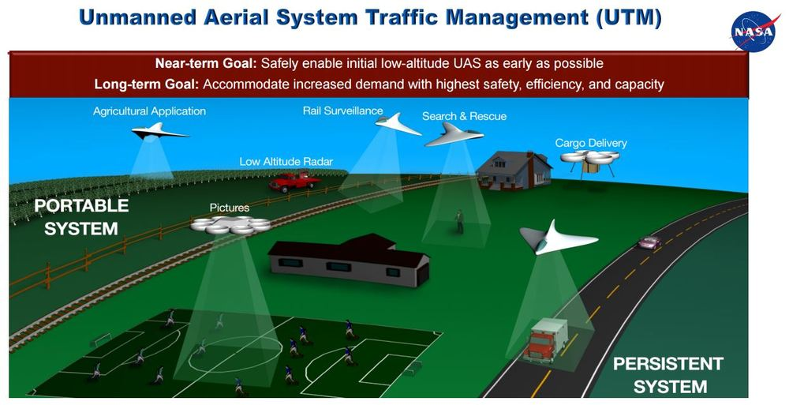
In 10 years!
How many drone deliveries are you going to allow simultaneously?
Who will decide who has authorization to record football practices?
Will privacy still exist?
What happens when the police want to use a UAS to monitor a crowd?
Will the drones crash into each other in flight?
Will there be an airborne Uber or Lyft?

Slide 52
Questions?
Email: bstark2@ucmerced.edu
UASSafety@ucmerced.edu
http://tinyurl.com/UC-UAS-COE
http://uassafety.ucmerced.edu/
Phone: (209) 201 - 2051
Facebook page: https://www.facebook.com/UC.UAS.Safety/
Please sign up for the UC UAS Listserves if you’d like to be kept in the loop of the latest developments
Other Presentations:
Drones in the UC System
SUAS Remote Pilot Certificate Exam
Drones for Student Clubs
Drones for Researchers
Drones for Staff

